Slide 1

Computational Systems Biology Deep Learning in the Life Sciences
6.802
6.874
20.390
20.490
HST.506
David Gifford Lecture 6
February 25, 2019
The Zen of PCA, t-SNE, and Autoencoders
http://mit6874.github.io
1

Slide 2
Today: Gene Expression, PCA, t-SNE, autoencoders
Gene expression analysis: The Biology of RNA-seq
Supervised (Classification) vs. unsupervised (Clustering)
Supervised: Differential expression analysis
Unsupervised: Embedding into lower dimensional space
Linear reduction of dimensionality
Principle Component Analysis
Singular Value Decomposition
Non-linear dimensionality reduction: embeddings
t-distributed Stochastic Network Embedding (t-SNE)
Building intuition: Playing with t-SNE parameters
Deep Learning embeddings
Autoencoders

Slide 3
1. The biology: RNA-seq data

Slide 4
RNA-Seq characterizes RNA molecules
export to cytoplasm
nucleus
A
B
C
High-throughput sequencing of RNAs at various stages of processing
mRNA
A
C
splicing
A
B
C
pre-mRNA or
ncRNA
transcription
A
B
C
Gene in genome
cytoplasm
Slide courtesy Cole Trapnell

Slide 5
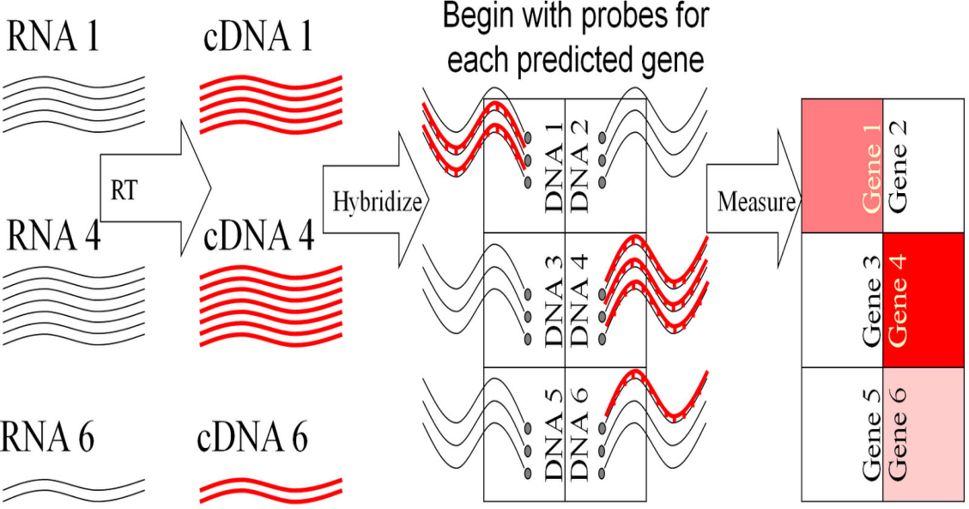
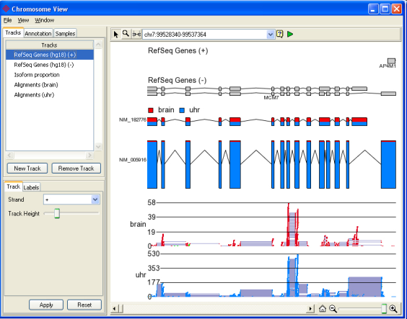
RNA-Seq: De novo tx reconstruction / quantification
Count
Microarray technology
Synthesize DNA probe array, complementary hybridization
Variations:
One long probe per gene
Many short probes per gene
Tiled k-mers across genome
Advantage:
Can focus on small regions, even if few molecules / cell
RNA-Seq technology:
Sequence short reads from mRNA, map to genome
Variations:
Count reads mapping to each known gene
Reconstruct transcriptome de novo in each experiment
Advantage:
Digital measurements, de novo

Slide 6
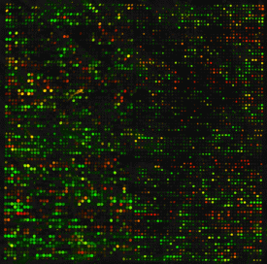
Expression Analysis Data Matrix
Measure 20,000 genes in 100s of conditions
Study resulting matrix
Condition 1
Condition 2
n experiments
Condition 3
…
Each experiment measures expression of thousands
of ‘spots’, typically genes
m genes
Expression profile of a gene
Gene similarity questions
Experiment similarity questions

Slide 7
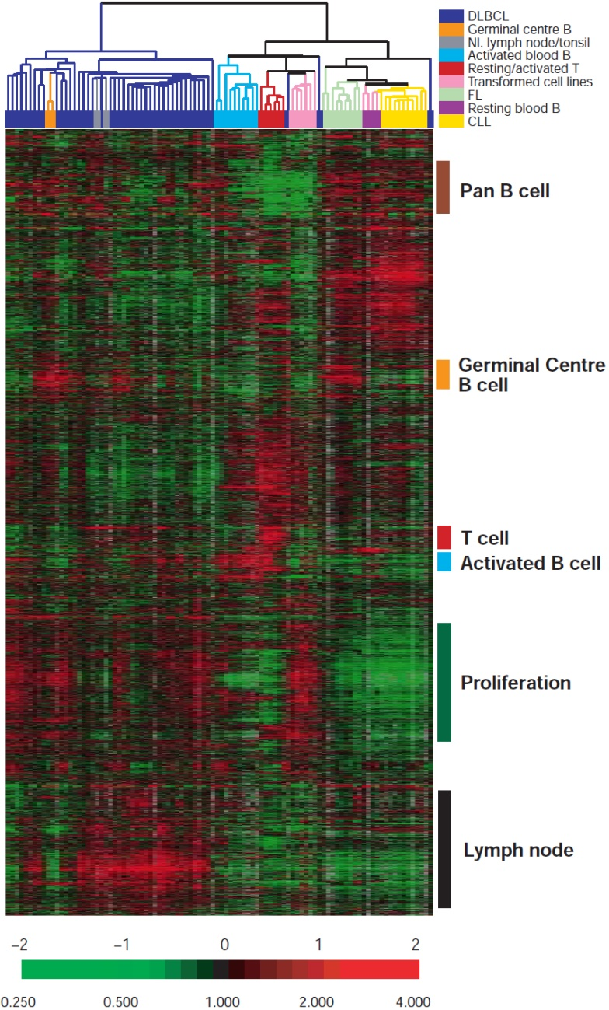

Clustering vs. Classification
Conditions→
Independent validation
of groups that emerge:
Conditions→
Known classes:
←Genes
Chronic
lymphocytic leukemia
←Genes
B-cell genes in
blood cell lines
Proliferation genes
in transformed cell lines
Lymph node genes in
diffuse large B-cell
lymphoma (DLBCL)
Alizadeh, Nature 2000
Alizadeh, Nature 2000
Goal of Clustering: Group similar items that likely come from the same category, and in doing so reveal hidden structure
Goal of Classification: Extract features from the data that best assign new elements to ≥1 of well-defined classes
Unsupervised learning
Supervised learning

Slide 8
Clustering vs Classification
Objects characterized by one or more features
Classification (supervised learning)
Have labels for some points
Want a “rule” that will accurately assign labels to new points
Sub-problem: Feature selection
Metric: Classification accuracy
Clustering (unsupervised learning)
No labels
Group points into clusters based on how “near” they are to one another
Identify structure in data
Metric: independent validation features
Genes
Proteins
Feature Y (liver expression)
Feature X (brain expression)
Feature Y (liver expression)
Feature X (brain expression)

Slide 9
Today: Gene Expression, PCA, t-SNE, autoencoders
Gene expression analysis: The Biology of RNA-seq
Supervised (Classification) vs. unsupervised (Clustering)
Supervised: Differential expression analysis
Unsupervised: Embedding into lower dimensional space
Linear reduction of dimensionality
Principle Component Analysis
Singular Value Decomposition
Non-linear dimensionality reduction: embeddings
t-distributed Stochastic Network Embedding (t-SNE)
Building intuition: Playing with t-SNE parameters
Deep Learning embeddings
Autoencoders

Slide 10
2. Supervised learning: differential gene expression

Slide 11
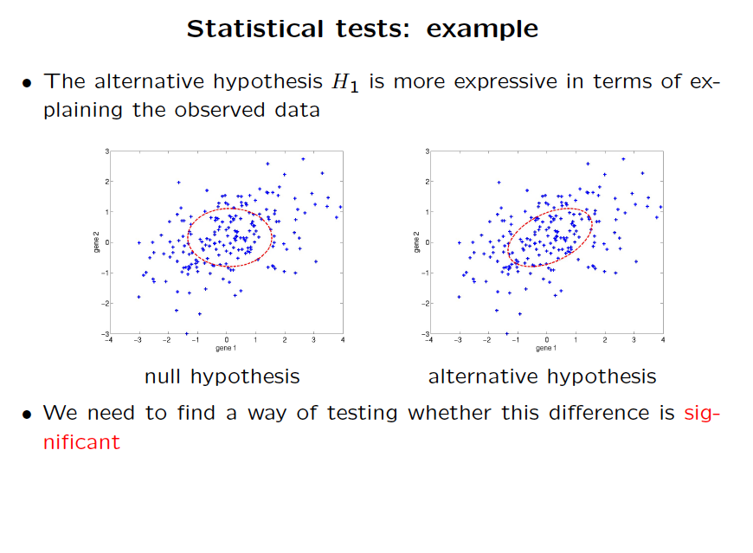

Slide 12
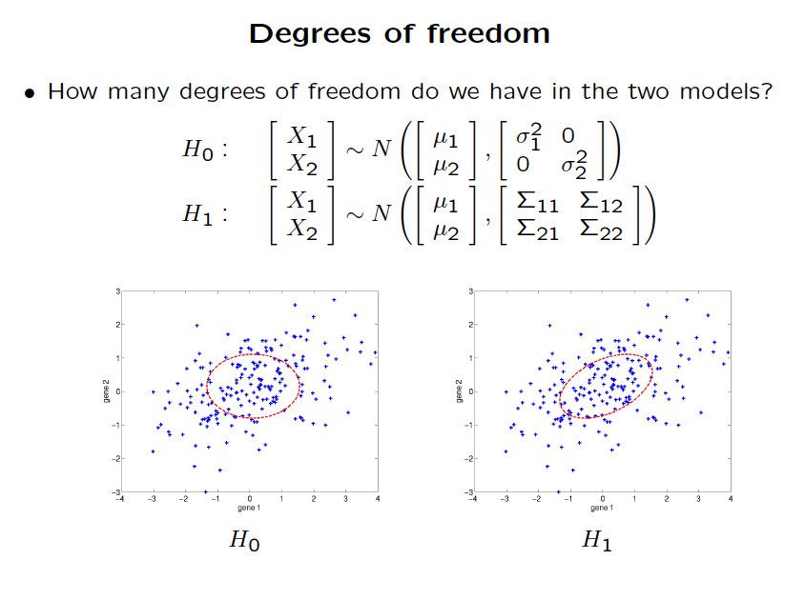

Slide 13
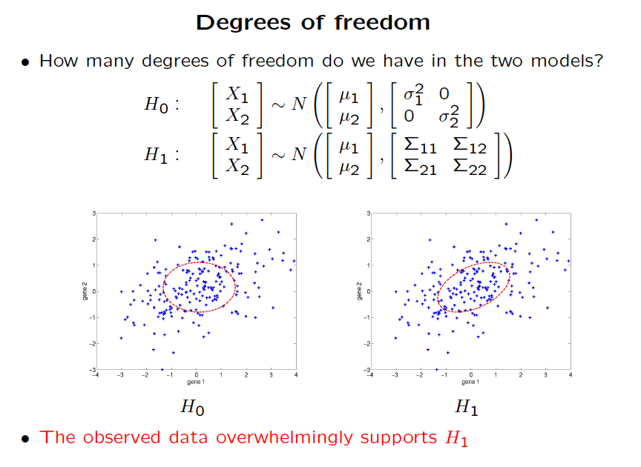

Slide 14
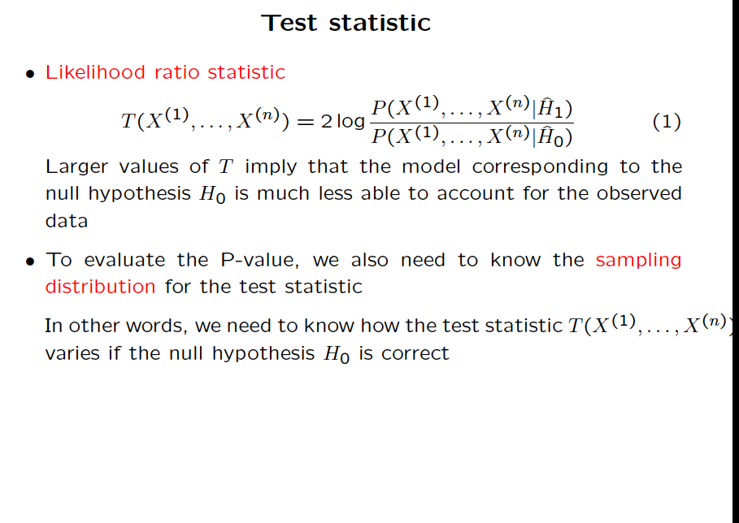

Slide 15
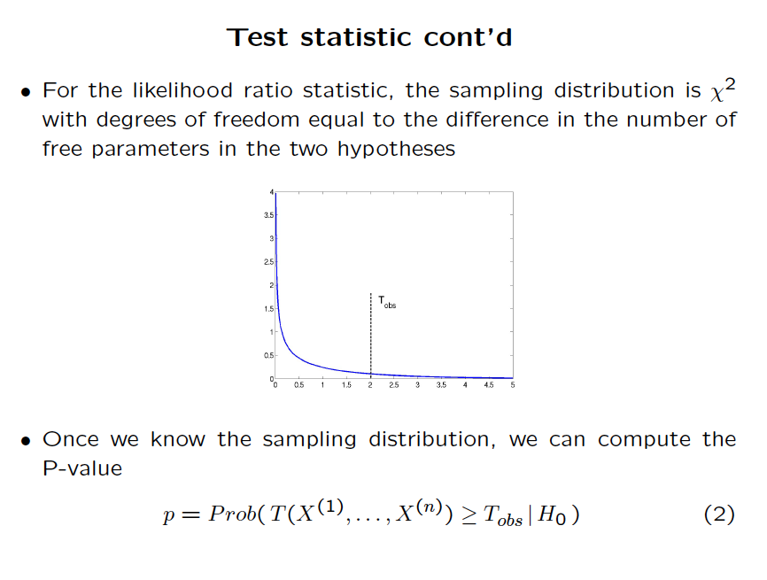

Slide 16
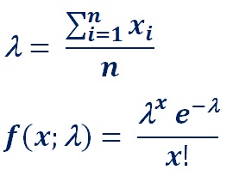
What is the right distribution for modeling read counts?
Poission?

Slide 17
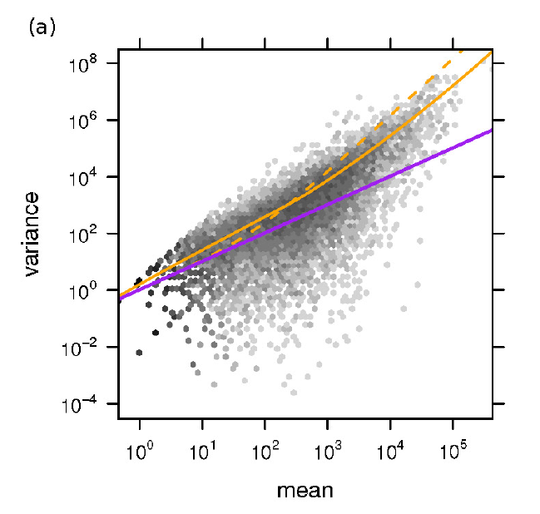
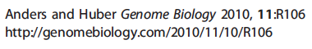
Read count data is overdispersed for a Poission
Use a Negative Binomial instead
Orange Line – DESeq
Dashed Orange – edgeR
Purple - Poission

Slide 18
A Negative Binomial distribution is better (DESeq)
i gene or isoform p condition
j sample (experiment) p(j) condition of sample j
m number of samples
K_{ij} number of counts for isoform i in experiment j
q_{ip} Average scaled expression for gene i condition p

Slide 19
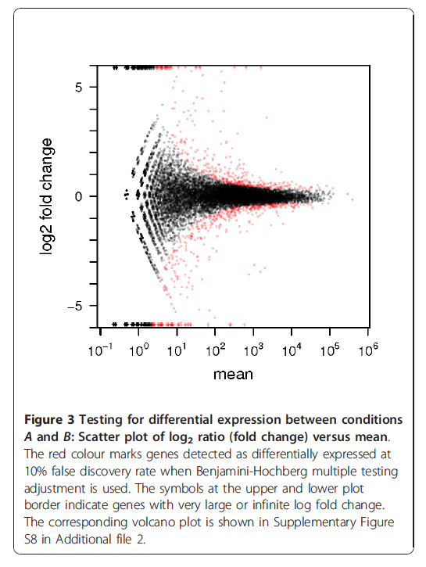

Slide 20
Hypergeometric test for gene set overlap significance
N – total # of genes 1000
n1 - # of genes in set A 20
n2 - # of genes in set B 30
k - # of genes in both A and B 3
0.017
0.020

Slide 21
Bonferroni correction
Total number of rejections of null hypothesis over all N tests denoted by R.
Pr(R>0) ~= Nα
Need to set α’ = Pr(R>0) to required significance level over all tests. Referred to as the experimentwise error rate.
With 100 tests, to achieve overall experimentwise significance level of α’=0.05:
0.05 = 100α
-> α = 0.0005
Pointwise significance level of 0.05%.

Slide 22
Example - Genome wide association screens
Risch & Merikangas (1996).
100,000 genes.
Observe 10 SNPs in each gene.
1 million tests of null hypothesis of no association.
To achieve experimentwise significance level of 5%, require pointwise p-value less than 5 x 10⁻⁸

Slide 23
Bonferroni correction - problems
Assumes each test of the null hypothesis to be independent.
If not true, Bonferroni correction to significance level is conservative.
Loss of power to reject null hypothesis.
Example: genome-wide association screen across linked SNPs – correlation between tests due to LD between loci.

Slide 24
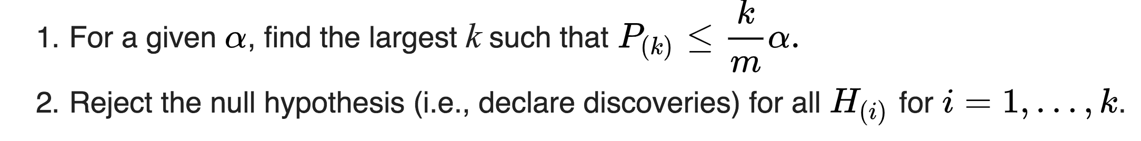
Benjamini Hochberg
Select False Discovery Rate α
Number of tests is m
Sort p-values P_{(k)} in ascending order (most significant first)
Assumes tests are uncorrelated or positively correlated

Slide 25
Today: Gene Expression, PCA, t-SNE, autoencoders
Gene expression analysis: The Biology of RNA-seq
Supervised (Classification) vs. unsupervised (Clustering)
Supervised: Differential expression analysis
Unsupervised: Embedding into lower dimensional space
Linear reduction of dimensionality
Principle Component Analysis
Singular Value Decomposition
Non-linear dimensionality reduction: embeddings
t-distributed Stochastic Network Embedding (t-SNE)
Building intuition: Playing with t-SNE parameters
Deep Learning embeddings
Autoencoders

Slide 26
3. Unsupervised learning:
dimensionality reduction

Slide 27
Dimensionality reduction has multiple applications
Uses:
Data Visualization
Data Reduction
Data Classification
Trend Analysis
Factor Analysis
Noise Reduction
Examples:
How many unique “sub-sets” are in the sample?
How are they similar / different?
What are the underlying factors that influence the samples?
Which time / temporal trends are (anti)correlated?
Which measurements are needed to differentiate?
How to best present what is “interesting”?
Which “sub-set” does this new sample rightfully belong?

Slide 28
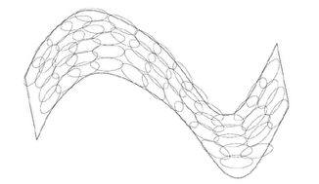
A manifold is a topological space that locally resembles Euclidean space near each point
A manifold embedding is a structure preserving mapping of a high dimensional space into a manifold
Manifold learning learns a lower dimensional space that enables a manifold embedding

Slide 29
Today: Gene Expression, PCA, t-SNE, autoencoders
Gene expression analysis: The Biology of RNA-seq
Supervised (Classification) vs. unsupervised (Clustering)
Supervised: Differential expression analysis
Unsupervised: Embedding into lower dimensional space
Linear reduction of dimensionality
Principle Component Analysis
Singular Value Decomposition
Non-linear dimensionality reduction: embeddings
t-distributed Stochastic Network Embedding (t-SNE)
Building intuition: Playing with t-SNE parameters
Deep Learning embeddings
Autoencoders

Slide 30
4. Principal Component Analysis

Slide 31
Example data
Example: 53 Blood and urine measurements (wet chemistry) from 65 people (33 alcoholics, 32 non-alcoholics)
Trivariate plot

Slide 32
Principal Component = axis of greatest variability
Suppose we have a population measured on p random variables X₁,…,X_{p}. Note that these random variables represent the p-axes of the Cartesian coordinate system in which the population resides. Our goal is to develop a new set of p axes (linear combinations of the original p axes) in the directions of greatest variability:
X₂
X₁
This is accomplished by rotating the axes.

Slide 33
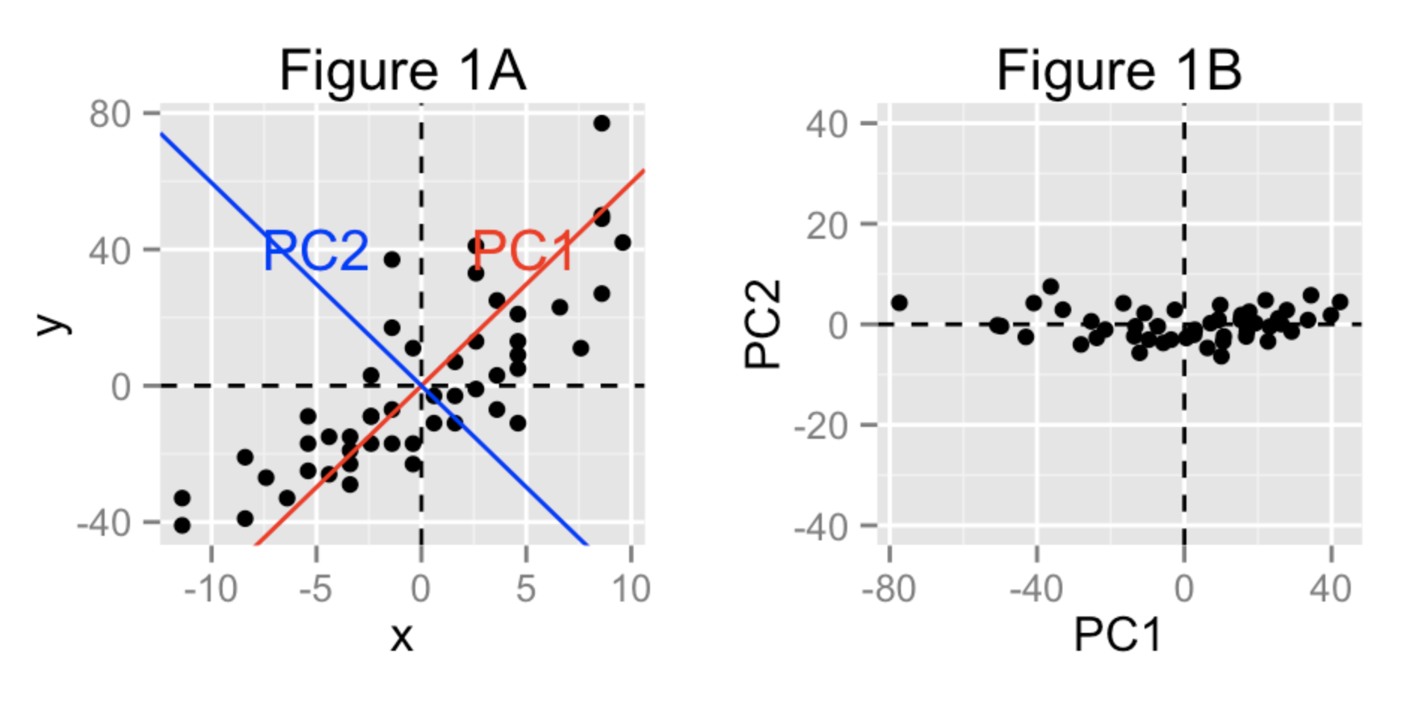
Data projected onto PC1

Slide 34
Selecting Principal Components
Given m points in a n dimensional space, for large n, how does one project on to a 1 dimensional space?
Formally, minimize sum of squares of distances to the line.
Why sum of squares? Because it allows fast minimization, assuming the line passes through 0

Slide 35

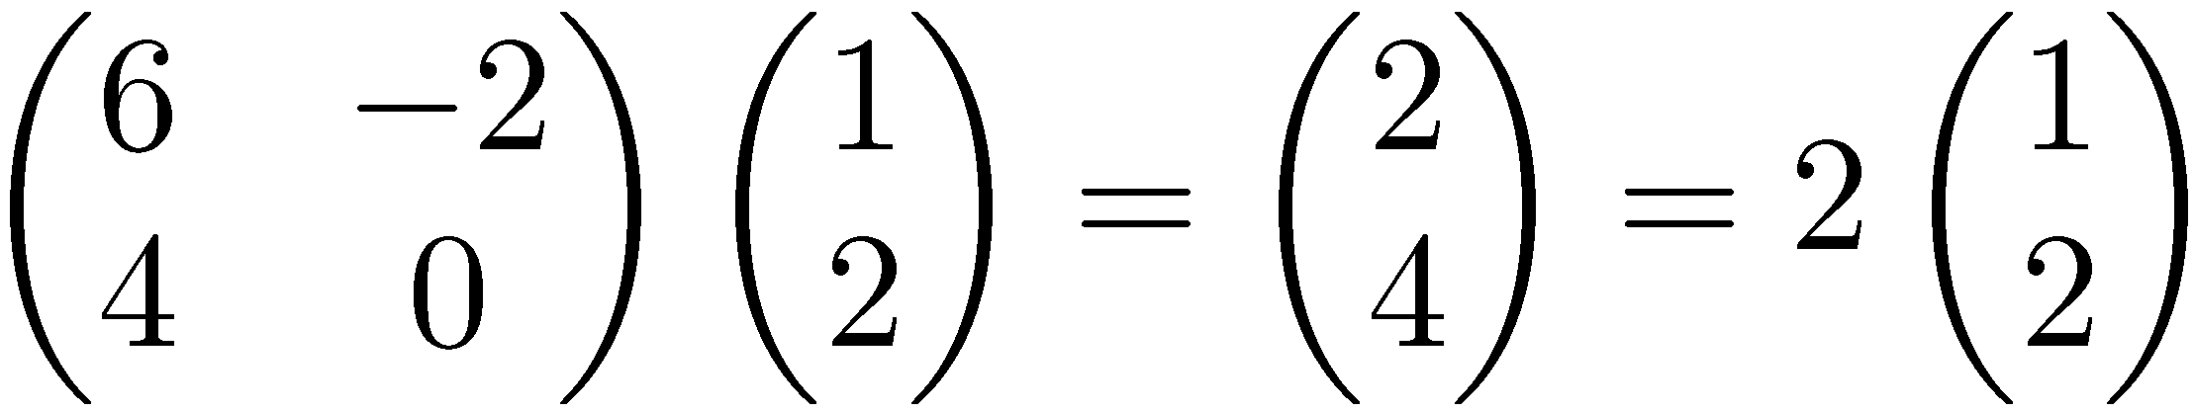
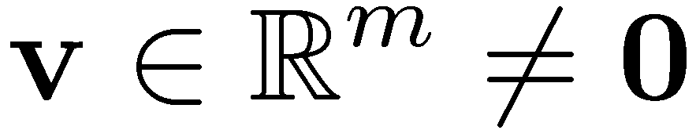

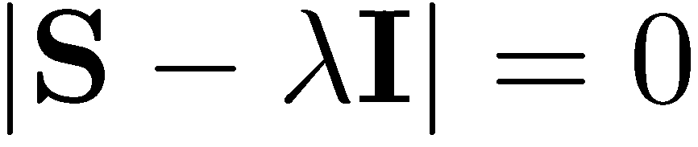
Linear Algebra Review
Eigenvectors (for a square m×m matrix S)
How many eigenvalues are there at most?
Example
(right) eigenvector
eigenvalue
only has a non-zero solution if
this is a m-th order equation in λ which can have at most m distinct solutions (roots of the characteristic polynomial) – can be complex even though S is real.

Slide 36
Eigenvalues & Eigenvectors
For symmetric matrices, eigenvectors for distinct
eigenvalues are orthogonal
All eigenvalues of a real symmetric matrix are real.
All eigenvalues of a positive semidefinite matrix
are non-negative

Slide 37
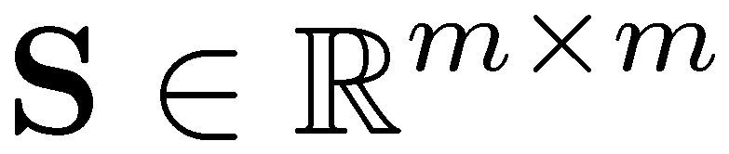
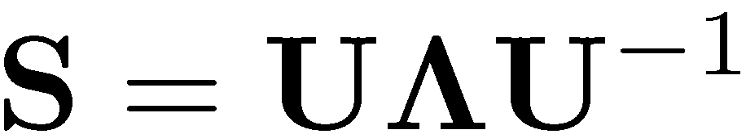


Eigen/diagonal Decomposition
Let be a square matrix with m linearly independent eigenvectors (a “non-defective” matrix)
Theorem: Exists an eigen decomposition
(cf. matrix diagonalization theorem)
Columns of U are eigenvectors of S
Diagonal elements of are eigenvalues of
v₁ v₂ v₃ … v_{m}
λ₁
λ₂
λ₃
…
λ_{m}
S = U Λ U⁻¹
Unique for distinct eigen-values
diagonal

Slide 38
Symmetric Eigen Decomposition
If is a symmetric matrix:
Theorem: Exists a (unique) eigen decomposition
where Q is orthogonal:
Q⁻¹= Q^{T}
Columns of Q are normalized eigenvectors
Columns are orthogonal.
(everything is real)

Slide 39
Today: Gene Expression, PCA, t-SNE, autoencoders
Gene expression analysis: The Biology of RNA-seq
Supervised (Classification) vs. unsupervised (Clustering)
Supervised: Differential expression analysis
Unsupervised: Embedding into lower dimensional space
Linear reduction of dimensionality
Principle Component Analysis
Singular Value Decomposition
Non-linear dimensionality reduction: embeddings
t-distributed Stochastic Network Embedding (t-SNE)
Building intuition: Playing with t-SNE parameters
Deep Learning embeddings
Autoencoders

Slide 40
5. Singular value decomposition (general m x n matrices)

Slide 41
Singular Value Decomposition
For an m× n matrix A of rank r there exists a factorization
(Singular Value Decomposition = SVD) as follows:
m×m
m×n
V is n×n
The columns of U are orthogonal eigenvectors of AA^{T}.
The columns of V are orthogonal eigenvectors of A^{T}A.
Eigenvalues λ₁ … λ_{r} of AA^{T} are the eigenvalues of A^{T}A.
Singular values.

Slide 42
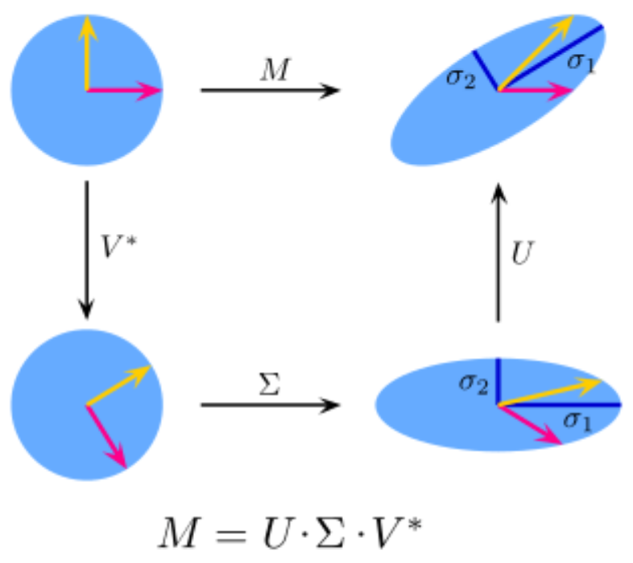
Geometric interpretation of SVD
Shearing
Rotation
Rotation
Scaling
Mx = M(x) = U( S( V*(x) ) )

Slide 43
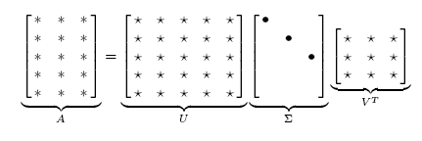
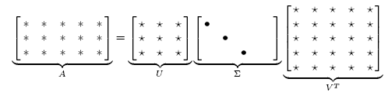
Singular Value Decomposition
Illustration of SVD dimensions and sparseness

Slide 44
Singular Value Decomposition-example
Let
Thus m=3, n=2. Its SVD is
Typically, the singular values arranged in decreasing order.

Slide 45
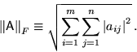
Low-rank Approximation
SVD can be used to compute optimal low-rank approximations.
Approximation problem: Find A_{k} of rank k such that
A_{k} and X are both m×n matrices.
Typically, want k << r.
Frobenius norm
(aka Euclidian norm)

Slide 46
Low-rank Approximation
Solution via SVD
set smallest r-k
singular values to zero
k
column notation: sum
of rank 1 matrices
Error:

Slide 47
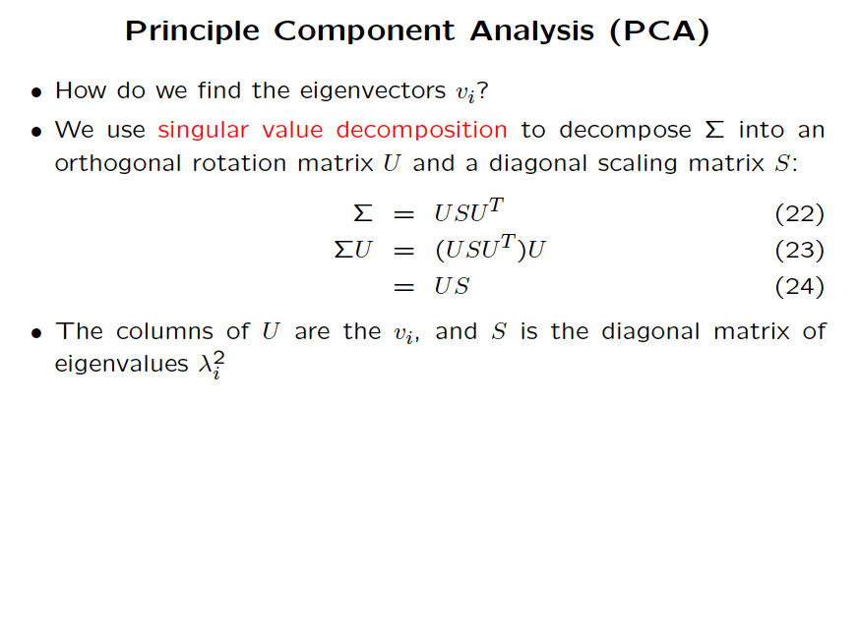

Slide 48
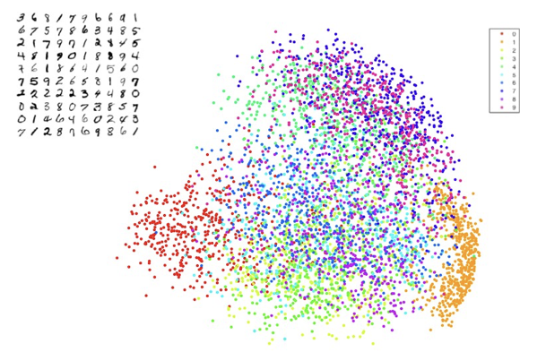
PCA of MNIST digits

Slide 49
Today: Gene Expression, PCA, t-SNE, autoencoders
Gene expression analysis: The Biology of RNA-seq
Supervised (Classification) vs. unsupervised (Clustering)
Supervised: Differential expression analysis
Unsupervised: Embedding into lower dimensional space
Linear reduction of dimensionality
Principle Component Analysis
Singular Value Decomposition
Non-linear dimensionality reduction: embeddings
t-distributed Stochastic Network Embedding (t-SNE)
Building intuition: Playing with t-SNE parameters
Deep Learning embeddings
Autoencoders

Slide 50
6. Non-linear embeddings: t-SNE

Slide 52
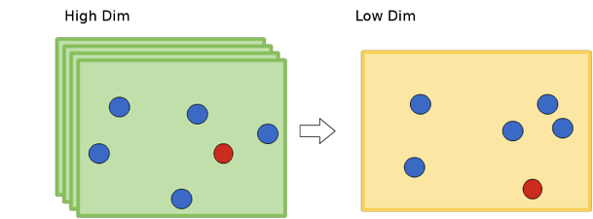
Neighborhood not preserved

Slide 53
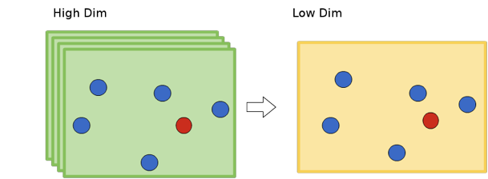
Neighborhood preserved

Slide 54
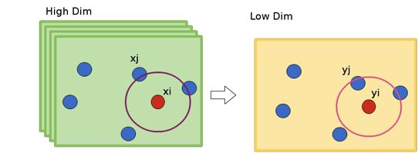
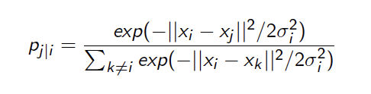
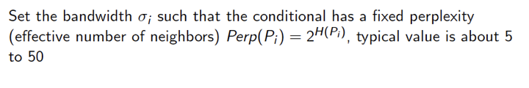
Measure pairwise distances in high dimensional space
Shannon entropy of P_{i}

Slide 55
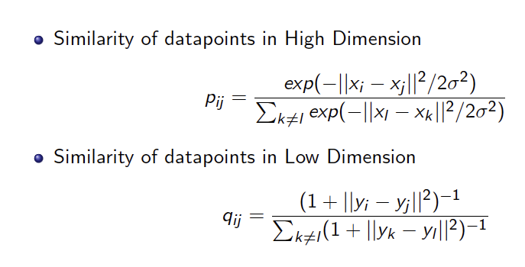
We want to choose an embedding that minimizes divergence between low and high dimension similarities

Slide 56
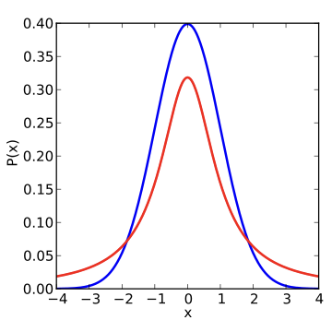
Low dimensional embedding using a Student t-distribution to avoid overcrowding
Red – Student t-distribution (1 degree of freedom)
Blue - Gaussian

Slide 57
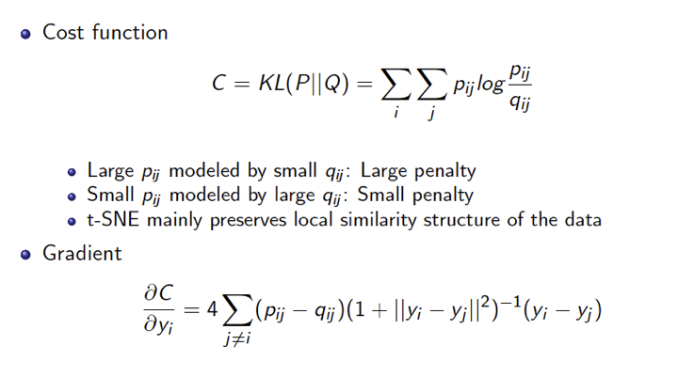
We can use gradient methods to find an embedding
p_{ij} = New (low) dimension distance
q_{ij} = Original (high) dimension D
(not okay to bring distant points closer)
(okay to separate nearby points)

Slide 58
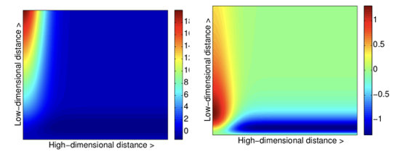
Interpretation of SNE (left) and t-SNE (right) gradients

Slide 59
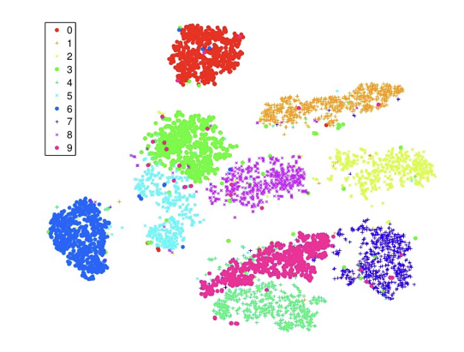
t-SNE of MNIST digits
0
1
3
2
6
5
8
9
7
4

Slide 60
Today: Gene Expression, PCA, t-SNE, autoencoders
Gene expression analysis: The Biology of RNA-seq
Supervised (Classification) vs. unsupervised (Clustering)
Supervised: Differential expression analysis
Unsupervised: Embedding into lower dimensional space
Linear reduction of dimensionality
Principle Component Analysis
Singular Value Decomposition
Non-linear dimensionality reduction: embeddings
t-distributed Stochastic Network Embedding (t-SNE)
Building intuition: Playing with t-SNE parameters
Deep Learning embeddings
Autoencoders

Slide 61
7. Playing with t-SNE parameters

Slide 62
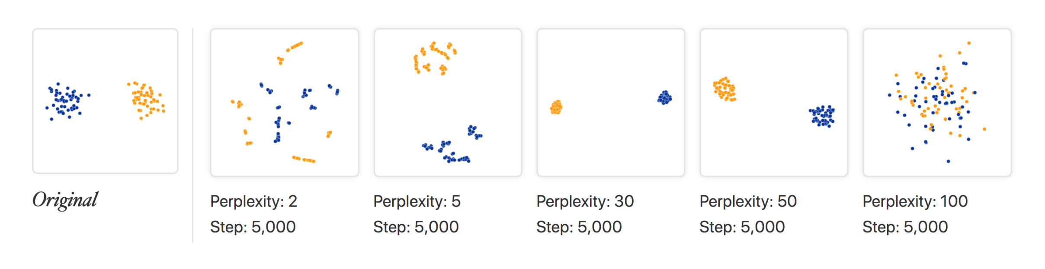
Perplexity matters
Recommended range by Van Der Maaten and Hinton
https://distill.pub/2016/misread-tsne/

Slide 63
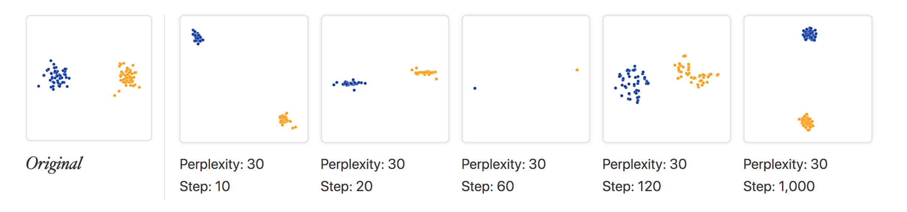
Number of steps matter
“pinched”:
Not enough steps
Too tight
Spread again
Tight again
https://distill.pub/2016/misread-tsne/

Slide 64
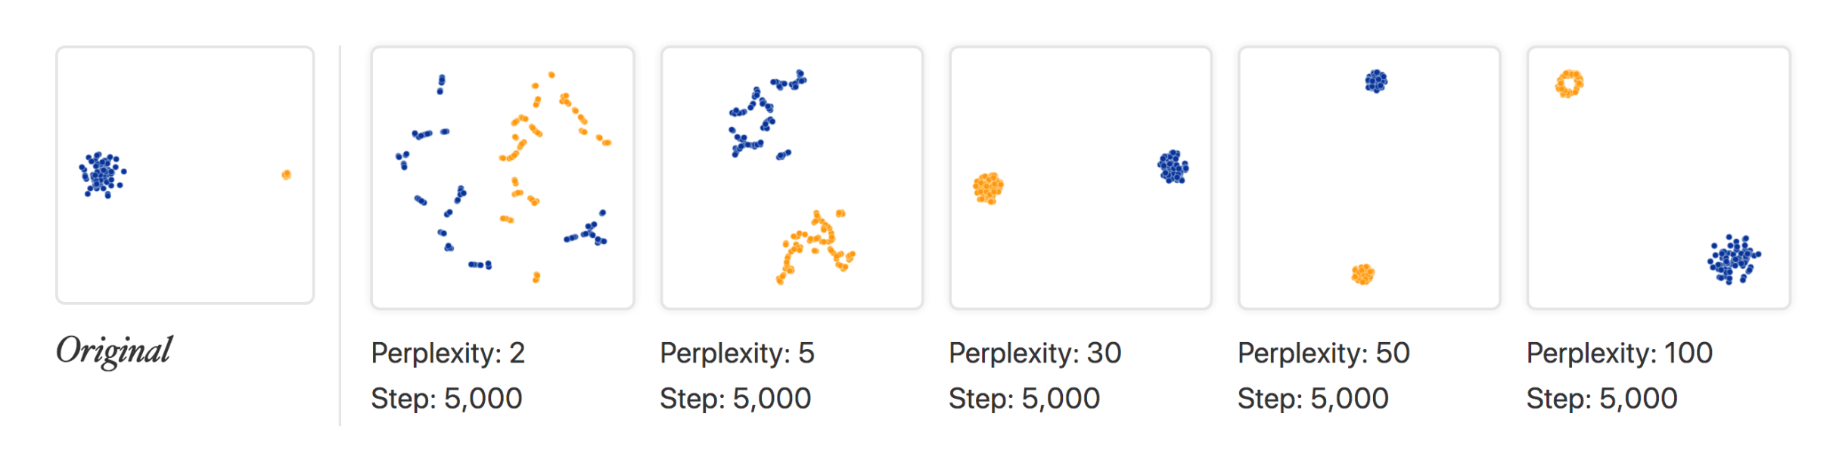
Cluster sizes are not meaningful
Original data: 2 Gaussians
Widely different (10-fold) dispersion
t-SNE loses that notion of distance.
By design, it adapts to regional variations in distance.
https://distill.pub/2016/misread-tsne/

Slide 65
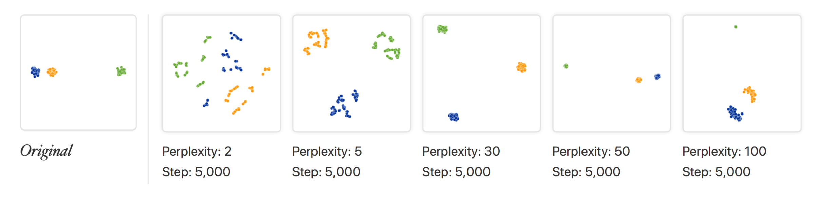
Between-cluster distance is not always preserved
Equidistant
Equidistant
Equidistant
Captured
Captured
https://distill.pub/2016/misread-tsne/

Slide 66
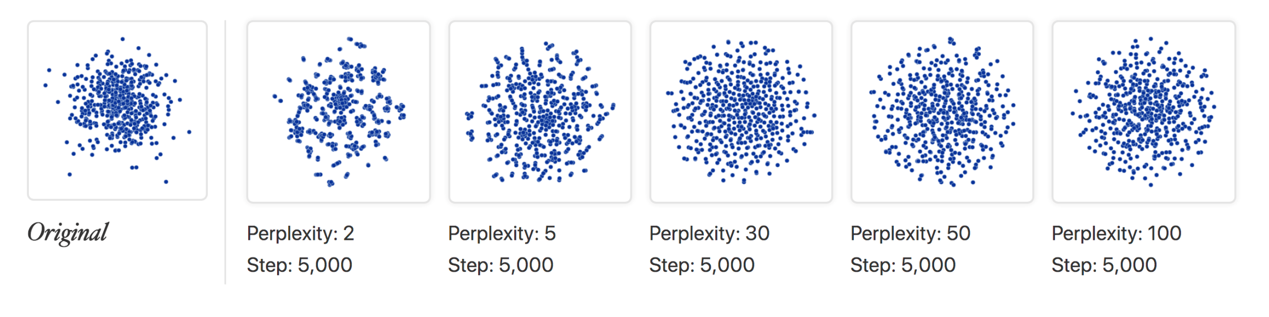
False clusters may appear
https://distill.pub/2016/misread-tsne/

Slide 67
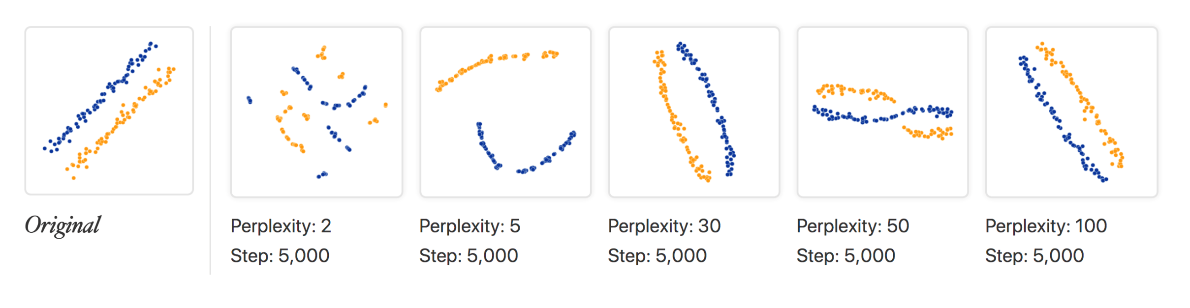
Relationships are not always preserved
https://distill.pub/2016/misread-tsne/

Slide 68
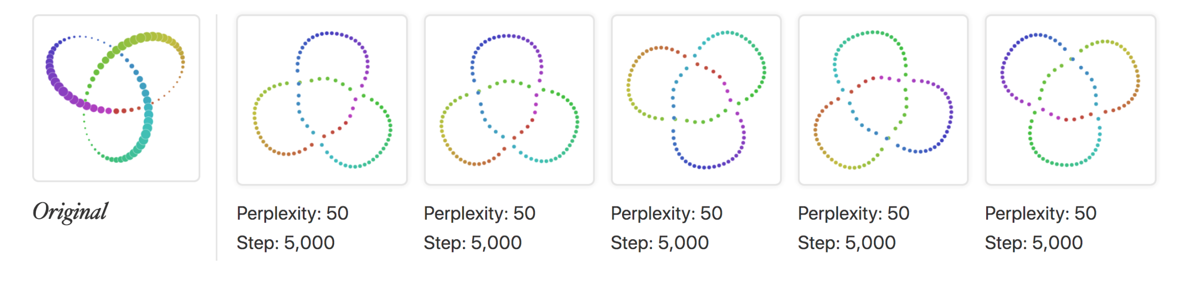
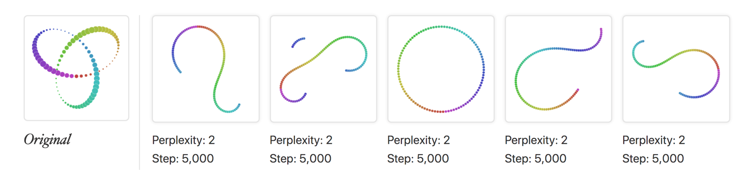
Different runs may produce similar results…
(but not at very low perplexity)
https://distill.pub/2016/misread-tsne/

Slide 69
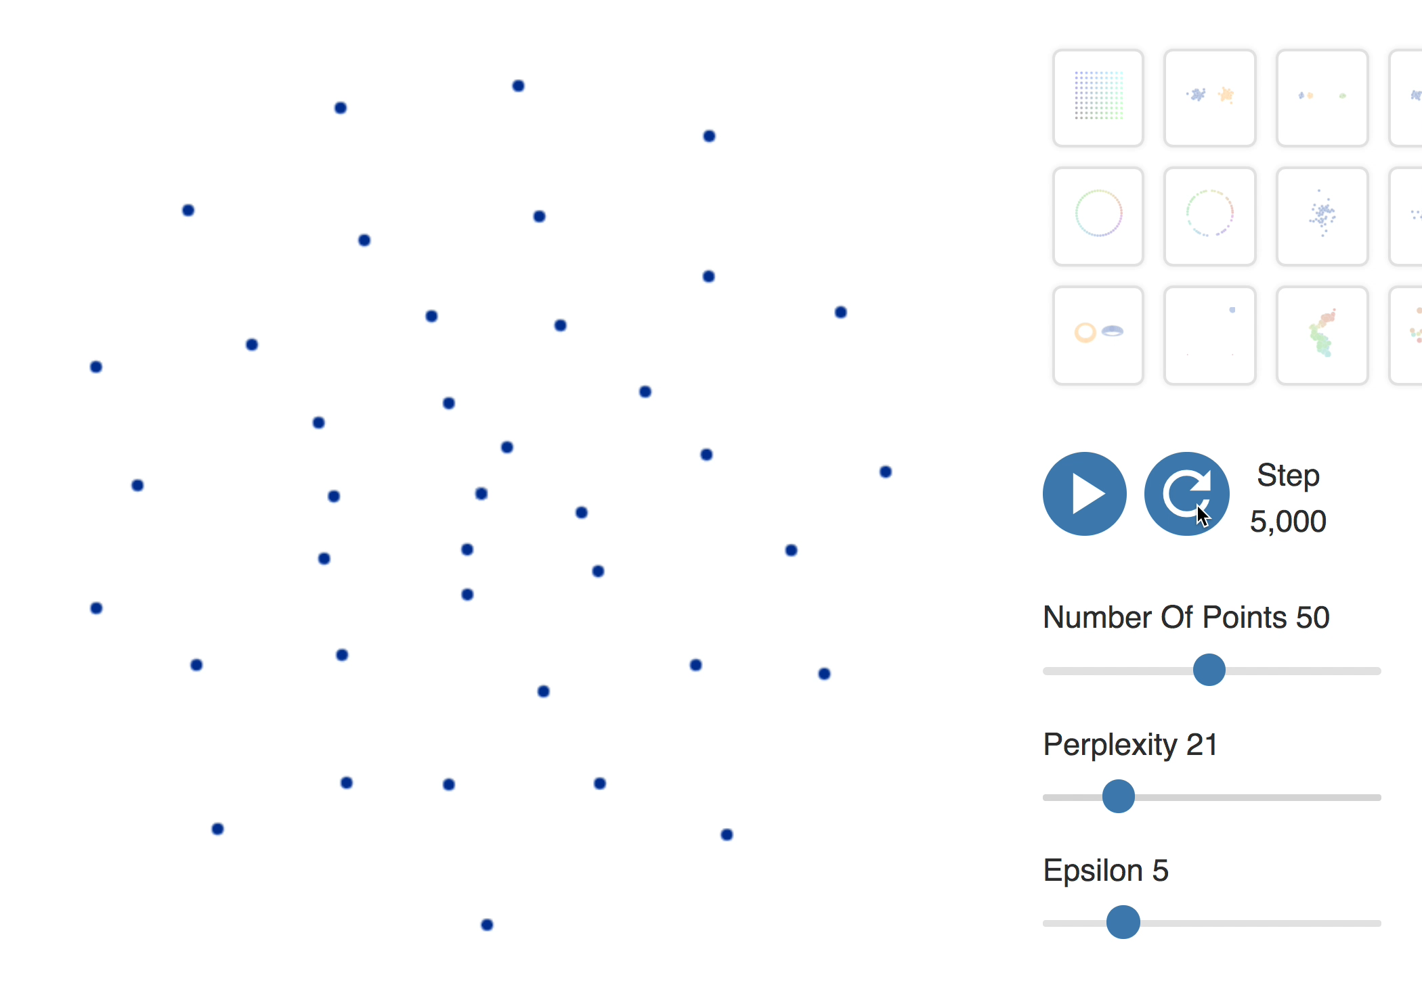
t-SNE of equidistant points
(#neighbors)
(learning rate)

Slide 70
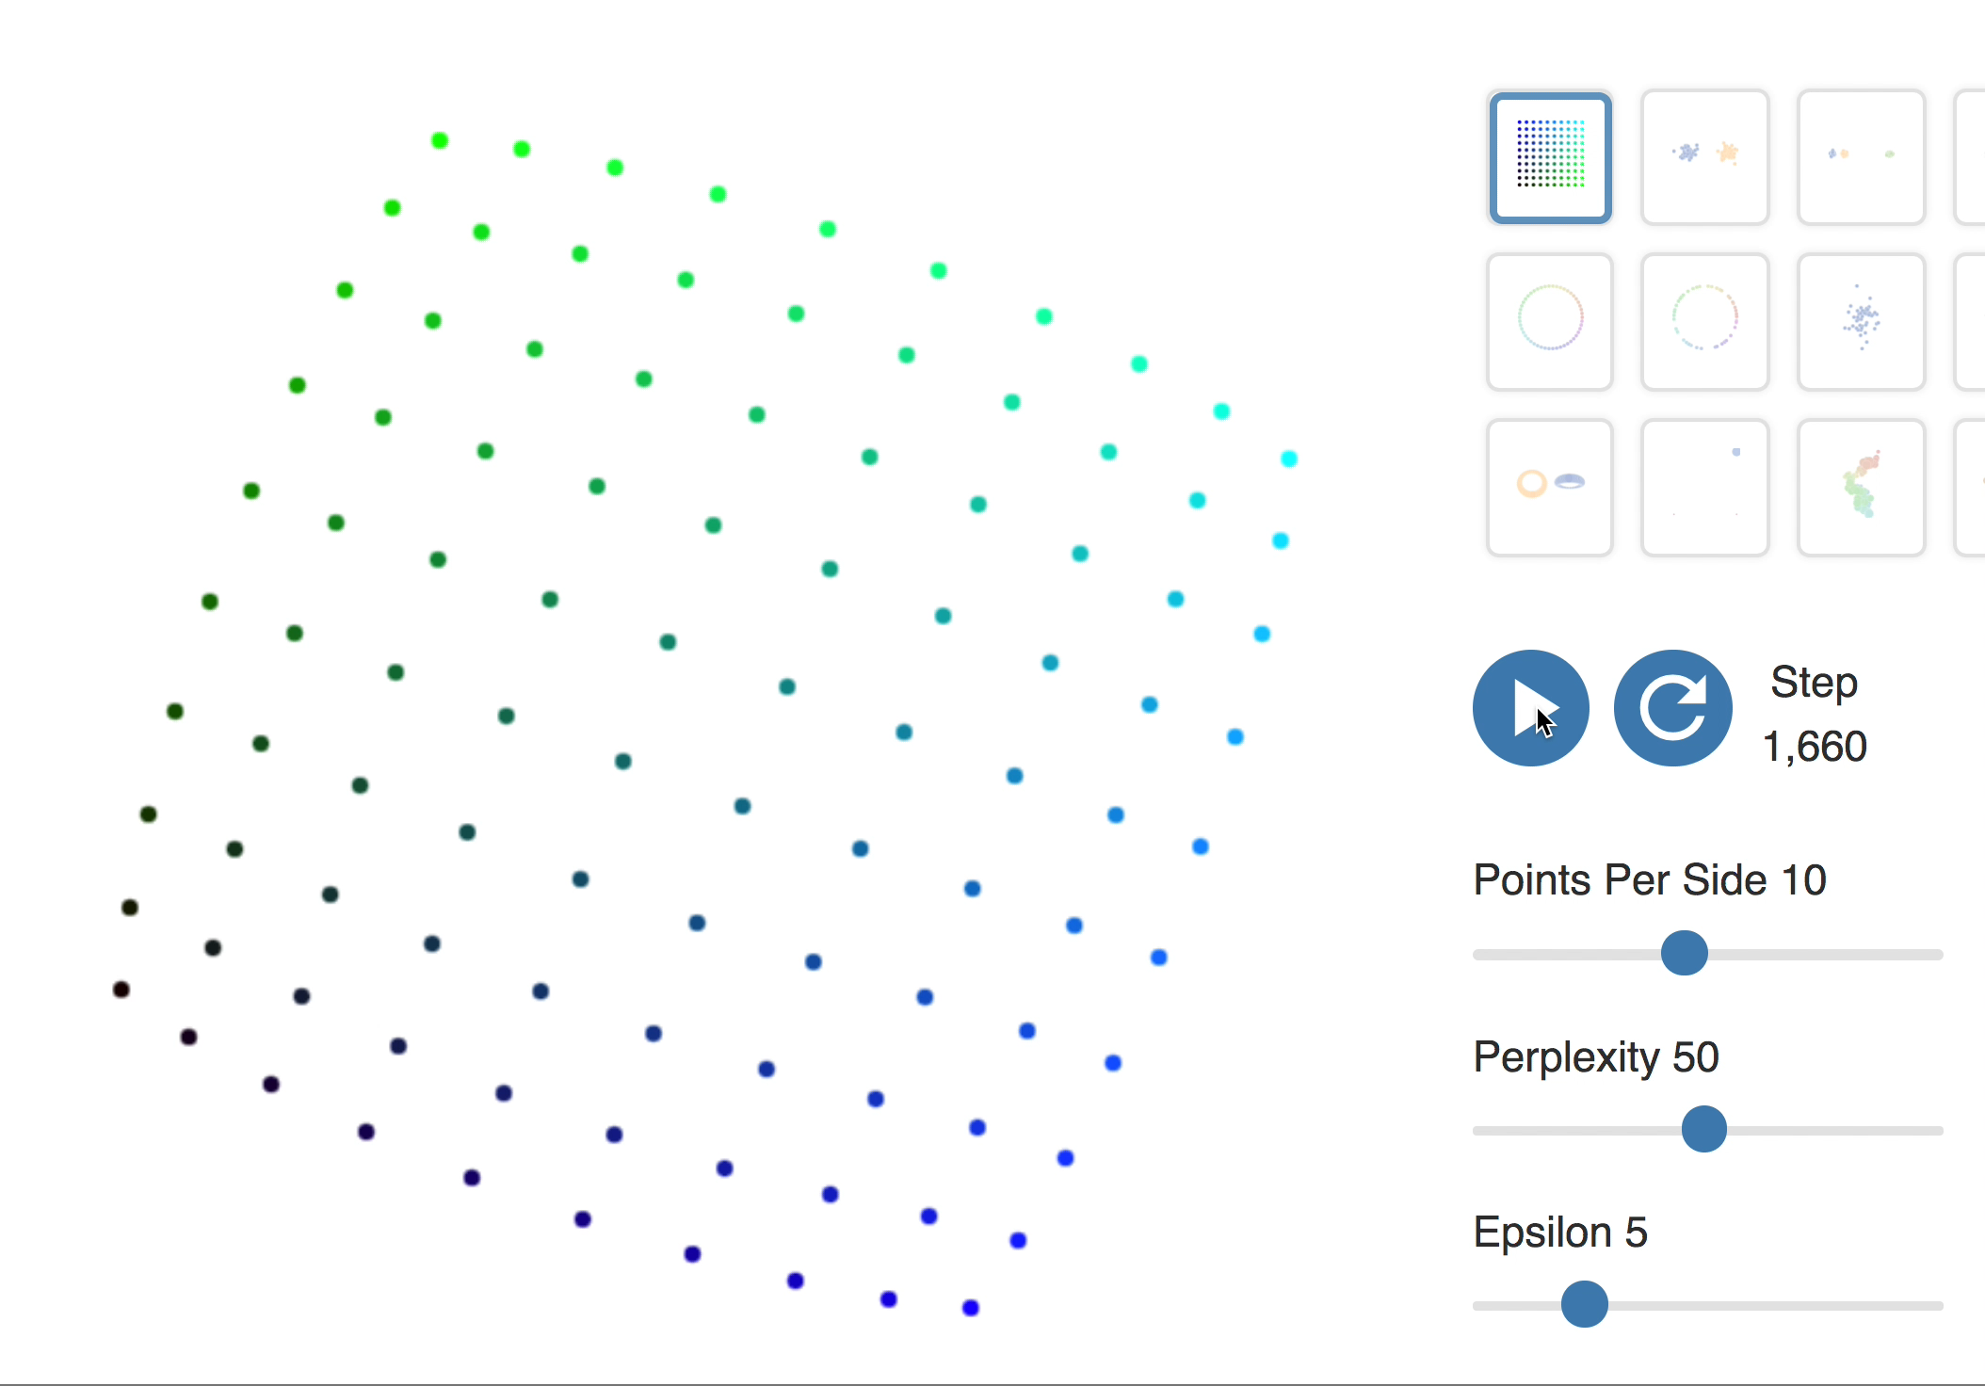
t-SNE of square grid
(#neighbors)
(learning rate)

Slide 71
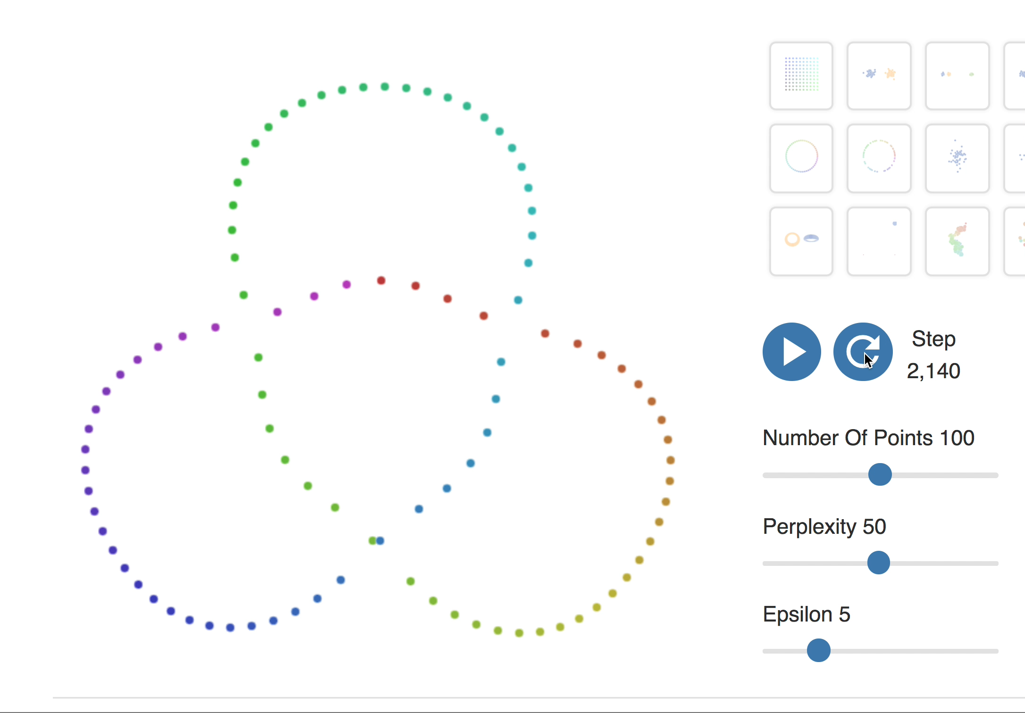
t-SNE of 3D Knot
(#neighbors)
(learning rate)

Slide 72
Today: Gene Expression, PCA, t-SNE, autoencoders
Gene expression analysis: The Biology of RNA-seq
Supervised (Classification) vs. unsupervised (Clustering)
Supervised: Differential expression analysis
Unsupervised: Embedding into lower dimensional space
Linear reduction of dimensionality
Principle Component Analysis
Singular Value Decomposition
Non-linear dimensionality reduction: embeddings
t-distributed Stochastic Network Embedding (t-SNE)
Building intuition: Playing with t-SNE parameters
Deep Learning embeddings
Autoencoders

Slide 73
8. Embedding with Deep learning:
Auto-encoders

Slide 74
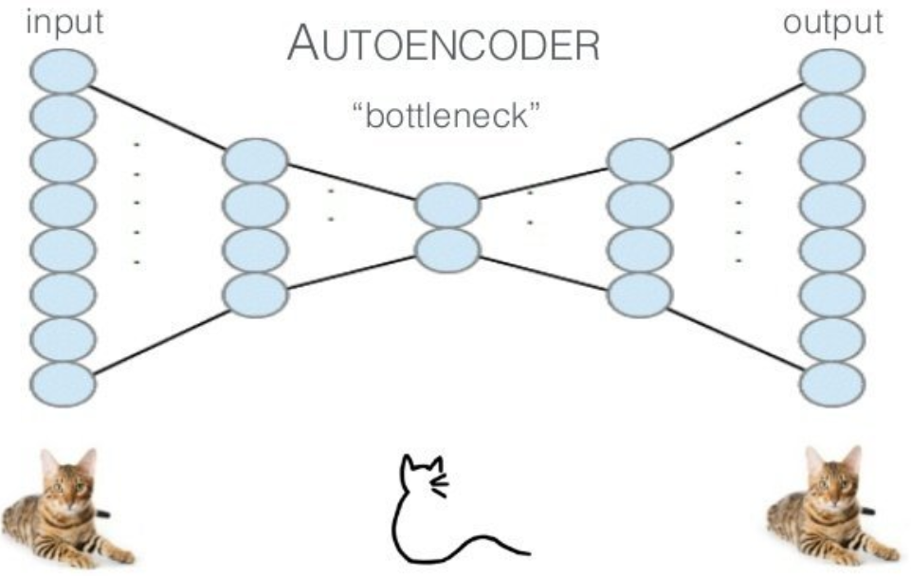
Autoencoder: dimensionality reduction with neural net
Tricking a supervised learning algorithm to work in unsupervised fashion
Feed input as output function to be learned. But! Constrain model complexity
Pretraining with RBMs to learn representations for future supervised tasks. Use RBM output as “data” for training the next layer in stack
After pretraining, "unroll” RBMs to create deep autoencoder
Fine-tune using backpropagation
[Hinton et al, 2006]

Slide 75
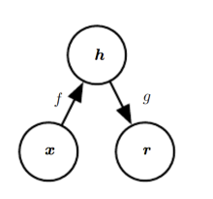

Autoencoders learn a latent representation of data

Slide 76



Denoising autoencoders recover signal corrupted by noise

Slide 77

We can learn manifolds with autoencoders

Slide 78


Auto-encoder learning of MNIST digit data
http://elf-project.sourceforge.net/autoencoder.html

Slide 79
Today: Gene Expression, PCA, t-SNE, autoencoders
Gene expression analysis: The Biology of RNA-seq
Supervised (Classification) vs. unsupervised (Clustering)
Supervised: Differential expression analysis
Unsupervised: Embedding into lower dimensional space
Linear reduction of dimensionality
Principle Component Analysis
Singular Value Decomposition
Non-linear dimensionality reduction: embeddings
t-distributed Stochastic Network Embedding (t-SNE)
Deep Learning embeddings
Autoencoders

Slide 80

FIN - Thank You

Slide 81
Interesting on-line demos
http://dpkingma.com/sgvb_mnist_demo/demo_old.html
http://elf-project.sourceforge.net/autoencoder.html
http://vdumoulin.github.io/morphing_faces/online_demo.html

